Slide 1
IEEE UCF SKILL SERIES
Embedded Programming 1
Part 1: Interrupts, LEDs, and Git

Slide 2
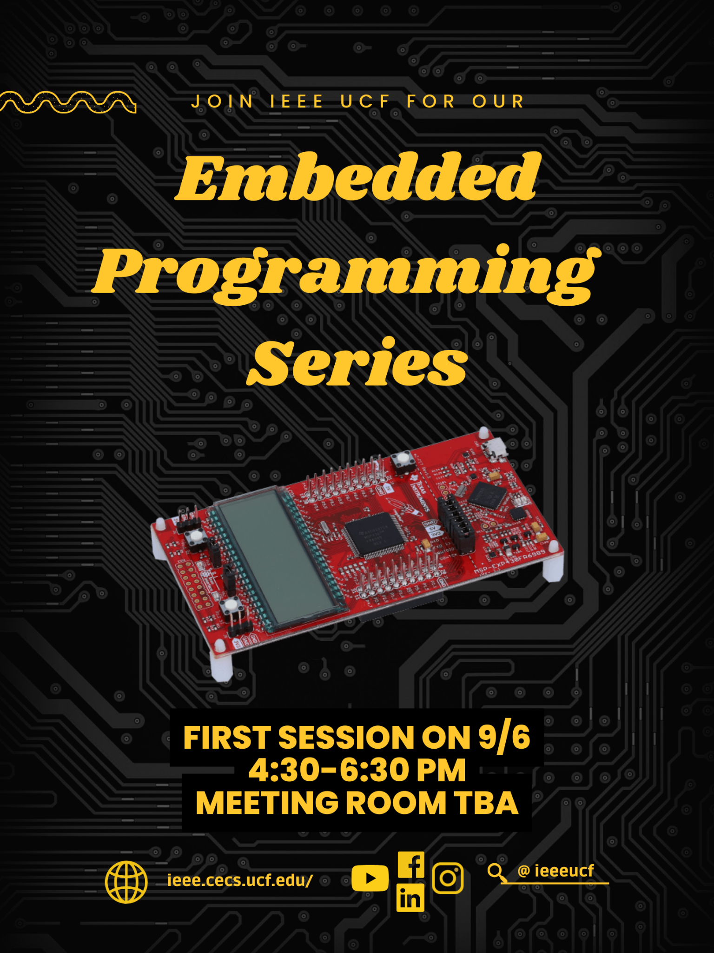

Slide 3

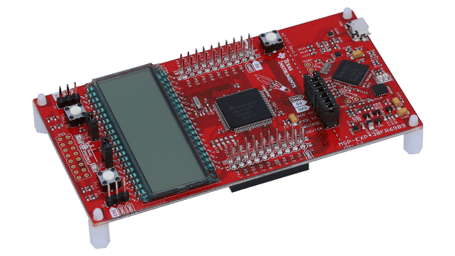
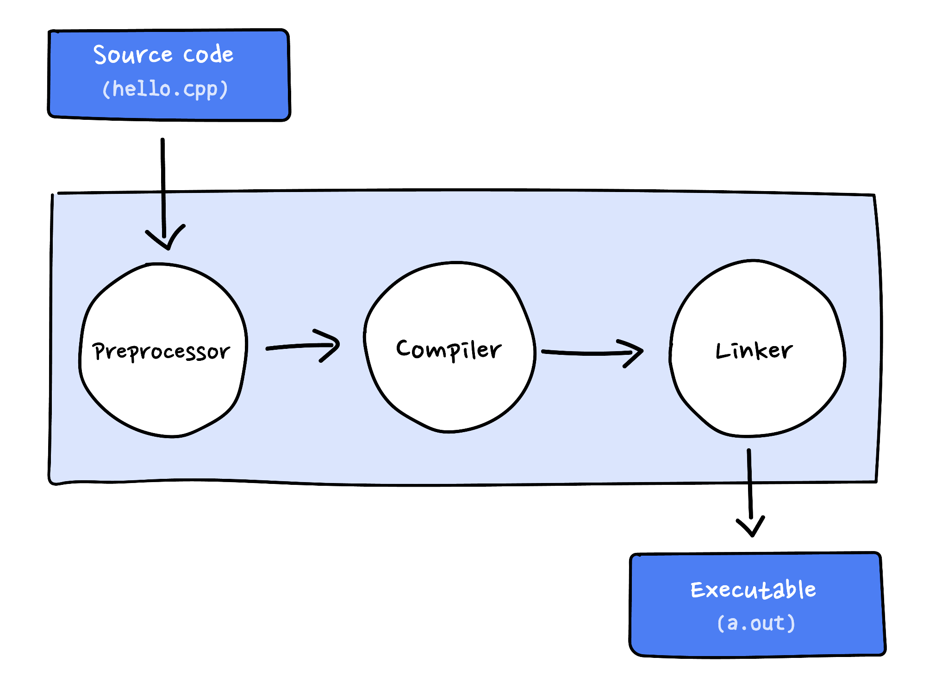
What you will learn today
How to use Git in a real-world example
Intro to microcontrollers and the MSP430
Bitwise operators and the C language
How to read a datasheet
Clocks, interrupts, LEDs
Compiling, linking, flashing

Slide 4
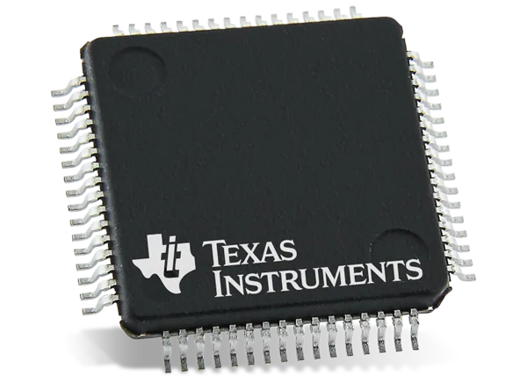
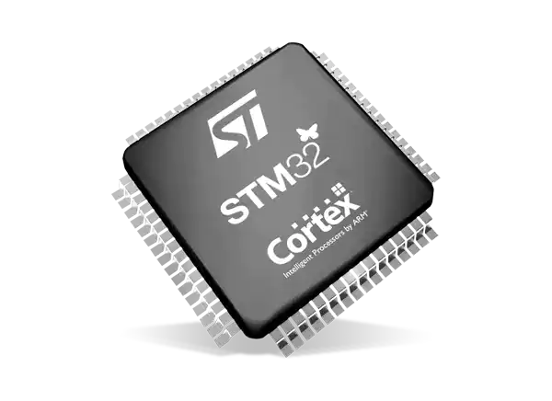
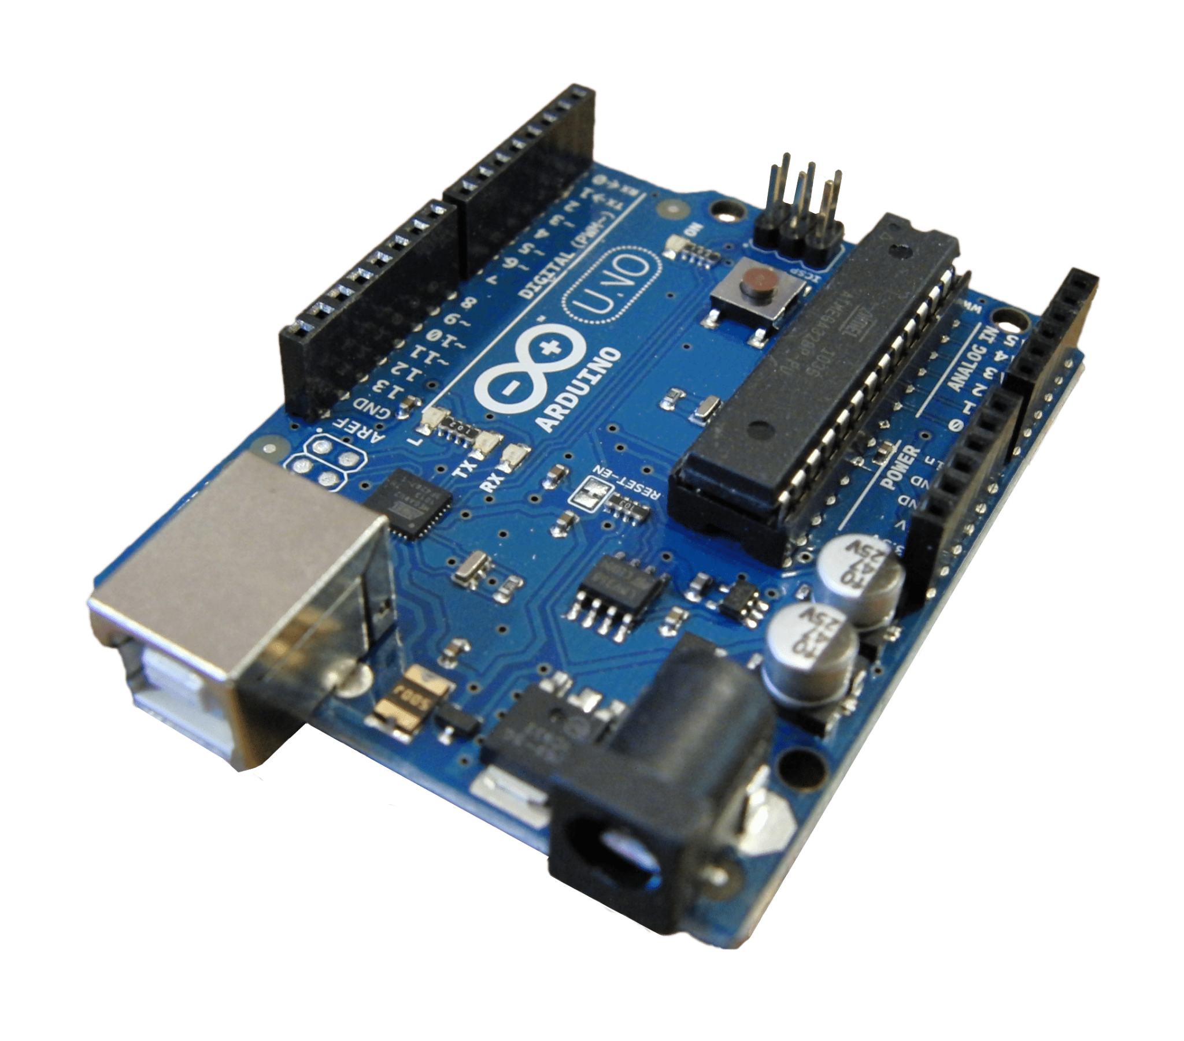
What is a microcontroller?
A small computer on an integrated circuit (IC)!
Contains processor(s), memory, I/O peripherals
Volatile and non-volatile memory
Revolutionized everyday products and more

Slide 5
Behind the scenes
Processors are designed to understand a set of machine language instructions. They include operations like load, store, add, multiply, and branch. We can write these instructions through assembly code, but this is too tedious for today’s applications!
Embedded software engineers often use high-level languages (easy for humans to understand) like C and Python. This means more abstraction (less customizability) but much faster to develop.

Slide 6
Behind the scenes cont.
Volatile memory: data that is only maintained with power
Non-volatile memory: permanently stored data
Why are these important? Every time you want to use your microwave, you rely on microcontrollers to remember what to do (data in non-volatile memory): spin the turntable, turn on the light inside, countdown to zero, etc. Think about how this could apply to more critical processes such as for military equipment! Volatile memory is also needed to hold runtime information such as sensor data and temporary data like variables.

Slide 7
Let’s start!!!
Download Texas Instruments' Code Composer Studio (CCS) IDE on your laptop here -> https://www.ti.com/tool/CCSTUDIO. Look for CCSTUDIO, click "Download options," then select the appropriate download link for your device. Start by trying the web installer link, but the offline installer should also work. Try opening CCS to make sure it works.
Download Git, create a GitHub account, and connect your GitHub account to Git -> https://docs.github.com/en/get-started/quickstart/set-up-git. Follow the 3 steps in the link.
Look up the chip we are using and find the relevant datasheets for later.

Slide 8

Let’s keep it goin’!!!
Fork the repository (keep your changes to yourself!)
This copies the code into your own “space” in the cloud where you are the owner
Open a terminal (cmd, powershell, terminal, etc.)
Clone the new repository (remote -> local copy)
This copies your new code in the cloud into a local folder on your computer
Change directory to the folder that you want the files to go in
“cd ../” to go back up a directory or “cd *FOLDERNAME*” to go into a folder
“git clone *URL*”
Observe the branch you’re on
“git branch -a”
“git status”

Slide 9
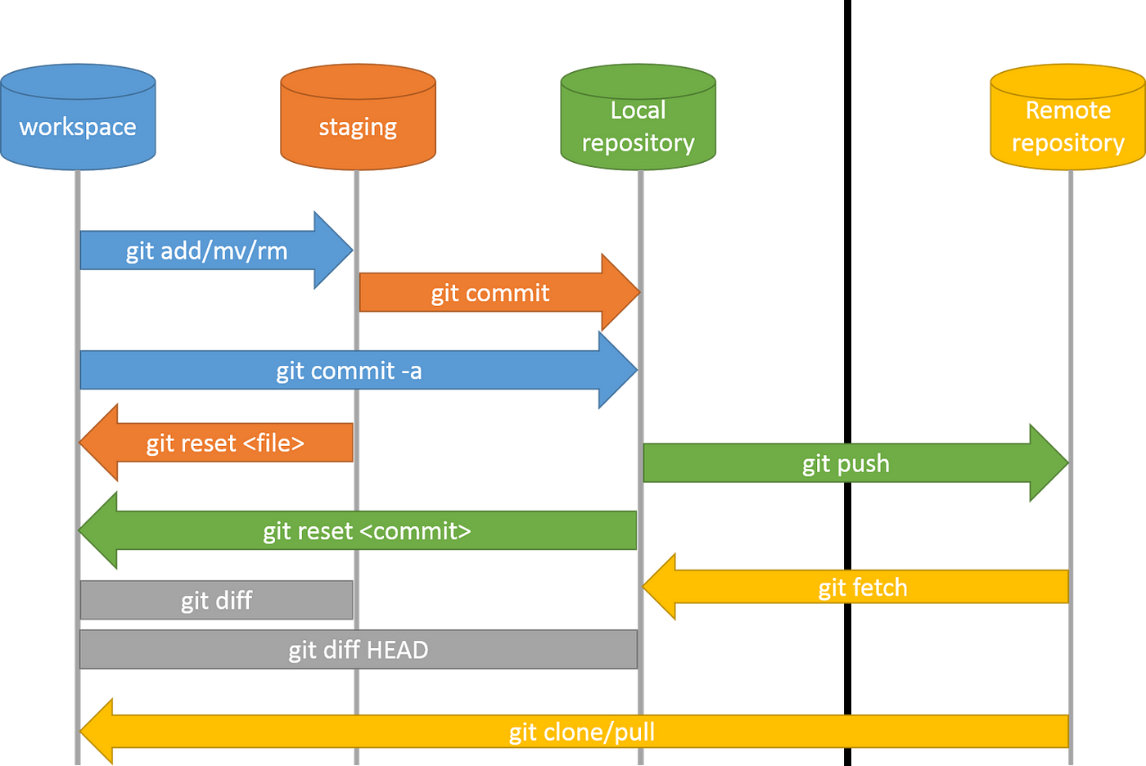

Slide 10

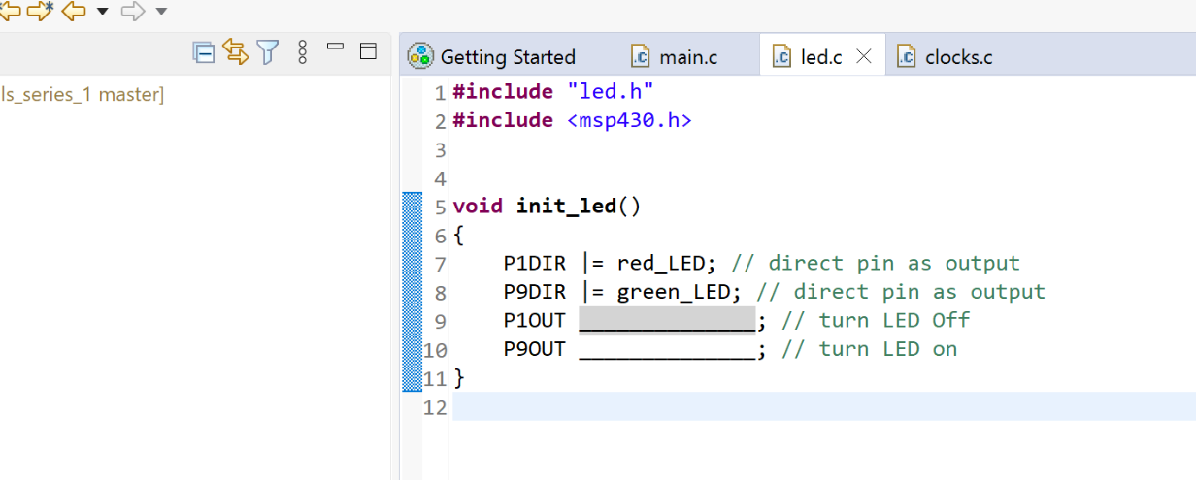
Can you fix the code?
Within CCS…
How do we use bitwise operators?
How do interrupts work?
Programming in C
Can you change the blinking speed of the LEDs? The order?
How do interrupts work?
Programming in C

Slide 11
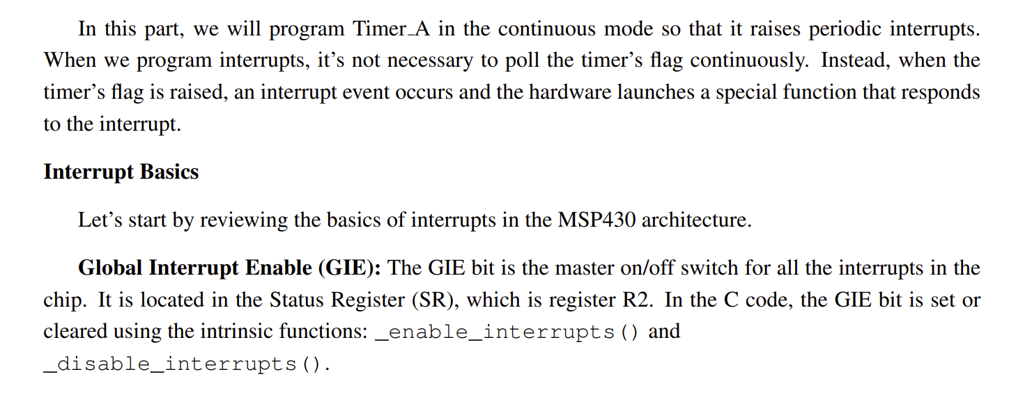
Interrupts

Slide 12
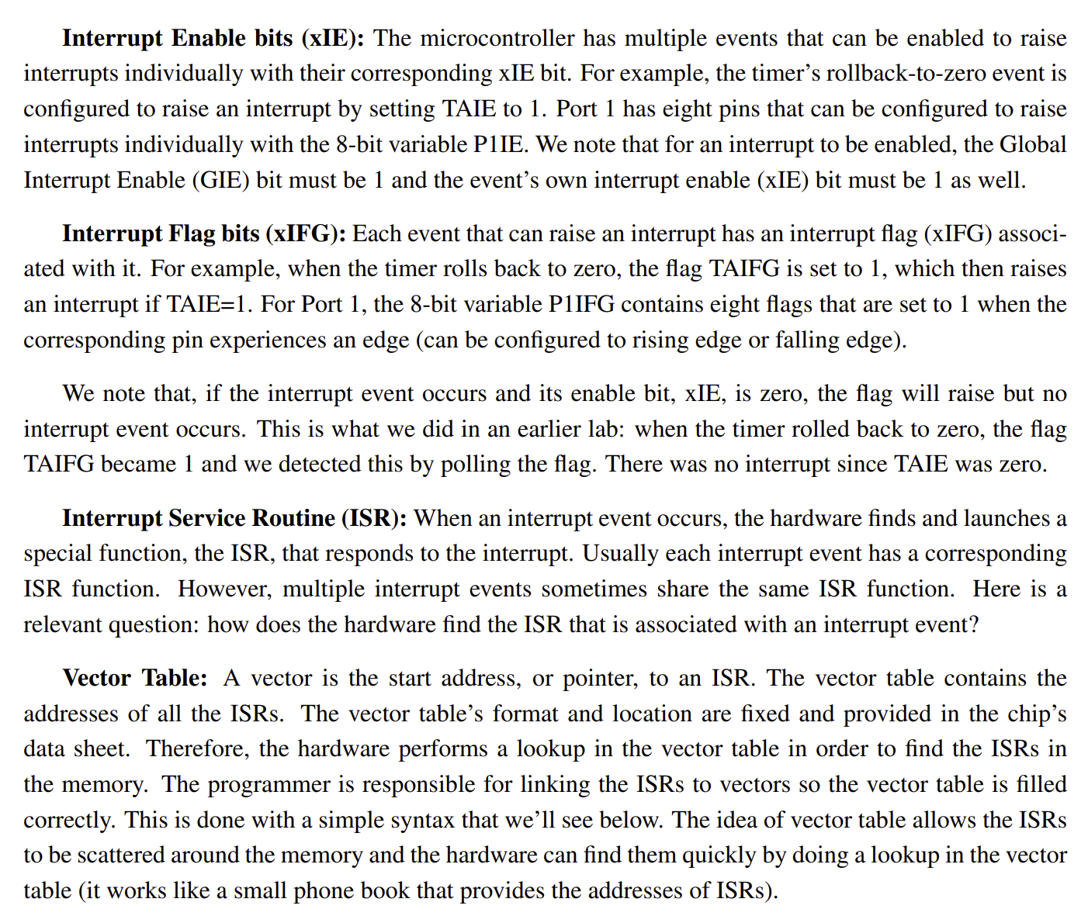

Slide 13
Compiling and linking

Slide 14
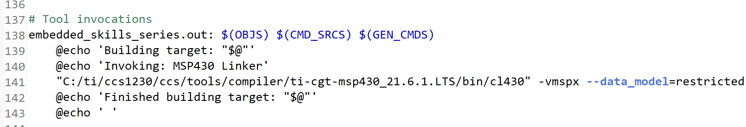
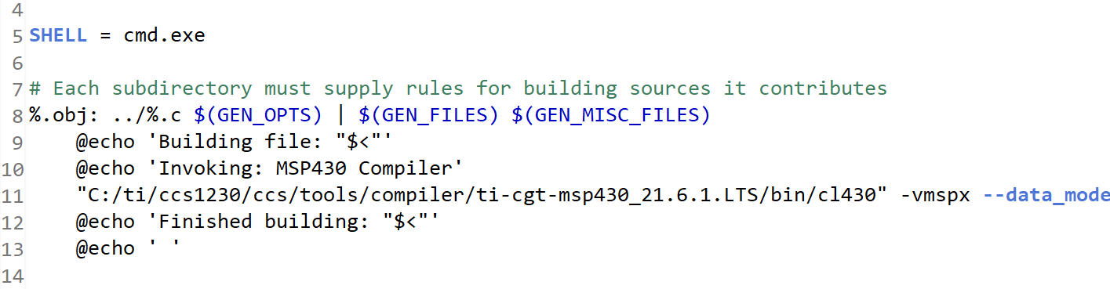

Slide 15

Almost done!!!
Add your edited files to be committed
“git add *FILENAME*”
Commit your changes (local)
git commit
Push your changes (local -> remote)
git push

Slide 16
Thanks for coming!

